Slide 1

MULESOFT DEMO

Slide 2
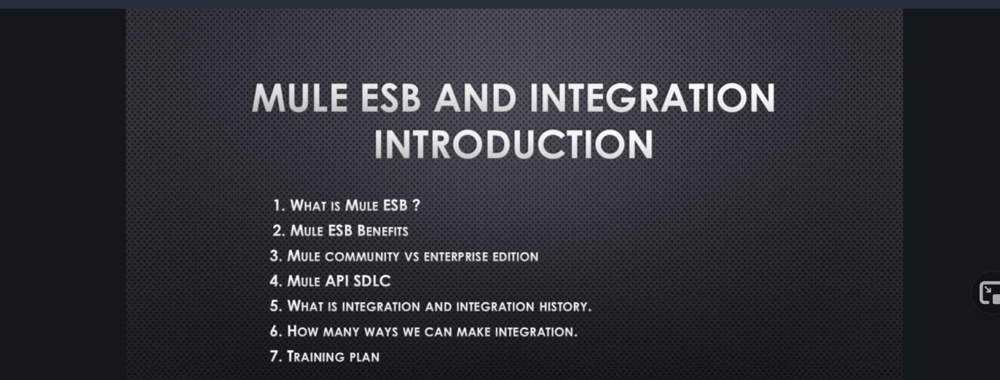

Slide 3
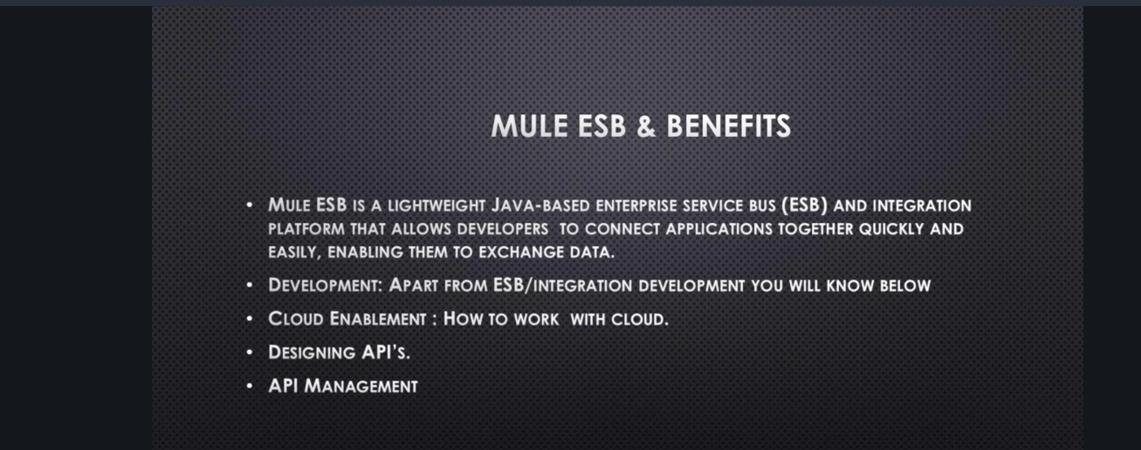

Slide 4
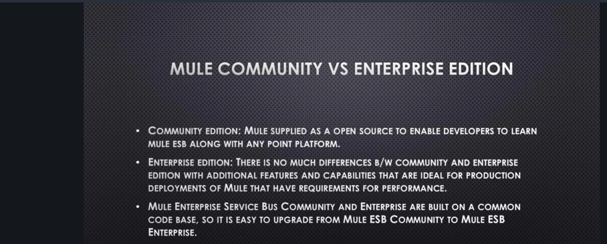

Slide 5
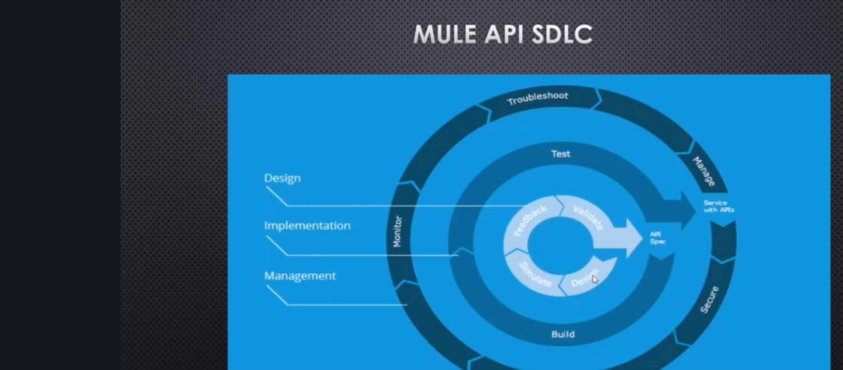
big concept

Slide 6
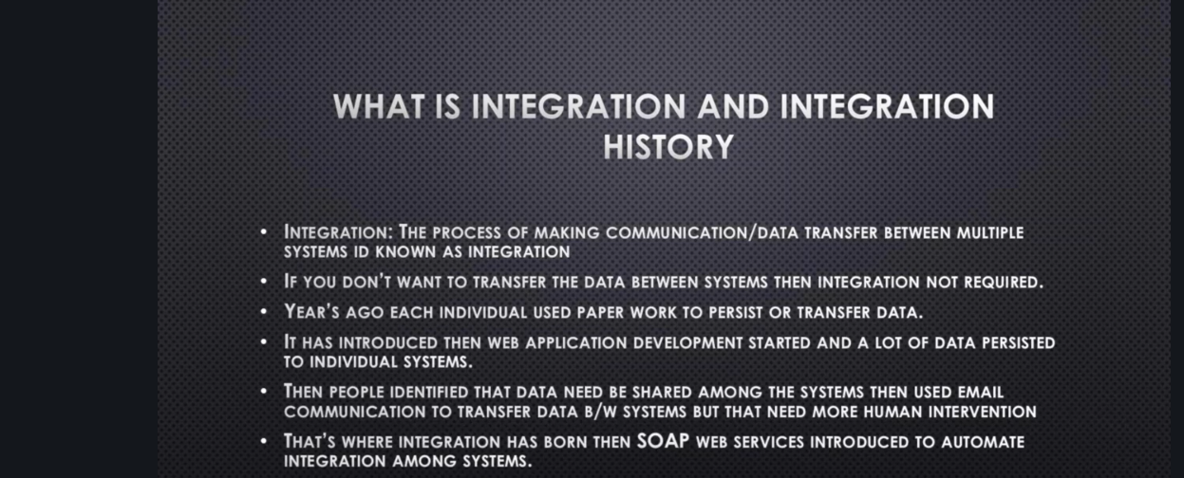

Slide 7
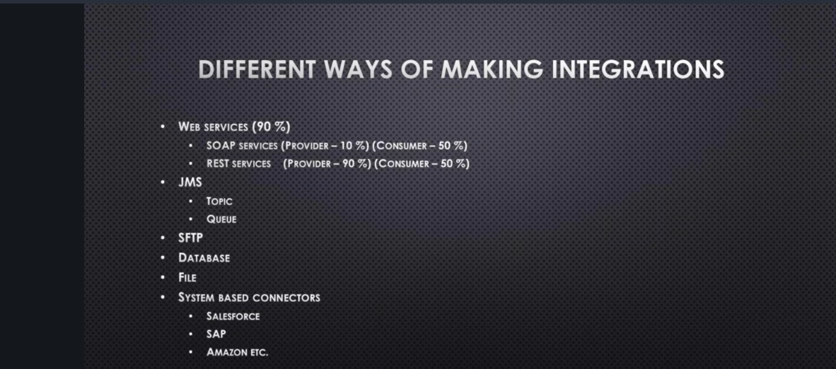

Slide 8
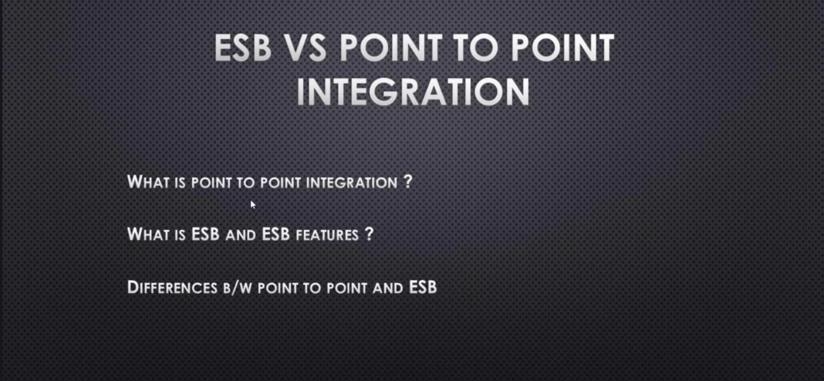

A PICTURE IS worth A THOUSAND WORDS

Slide 9

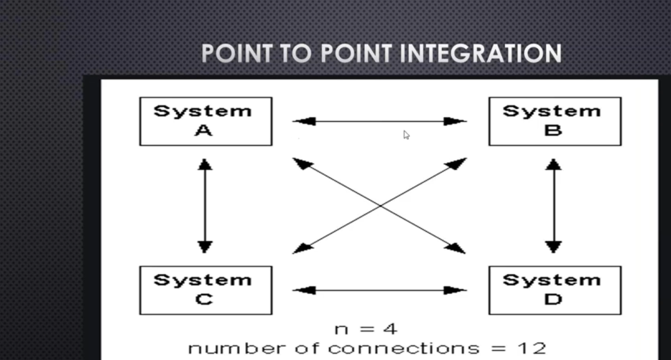
want big impact?
USE BIG image

Slide 10
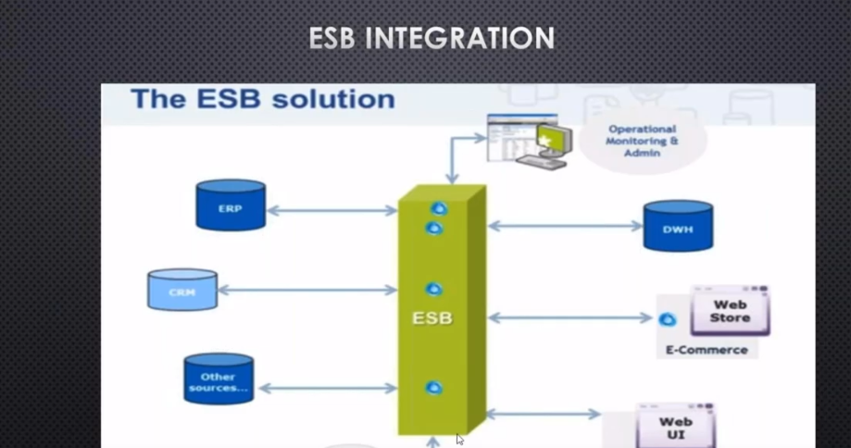
USE CHARTS TO EXPLAIN YOUR ideas
White
Gray
Black

Slide 11
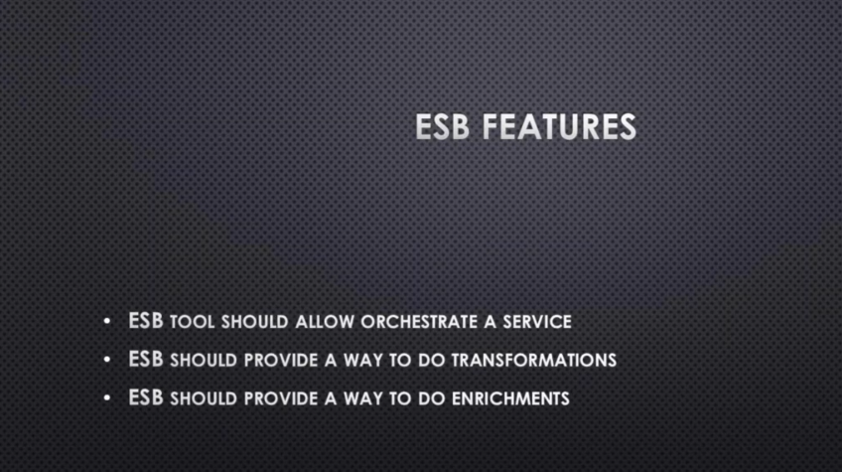
AND TABLES TO compare DATA
 | a | b | c
Yellow | 10 | 20 | 7
Blue | 30 | 15 | 10
Orange | 5 | 24 | 16

Slide 12
Why Only Mulesoft
Mulesoft is Open source-low cost
It is acquired by salesforce
Flexible to connect to any system
It is easy to learn
our office

Slide 13
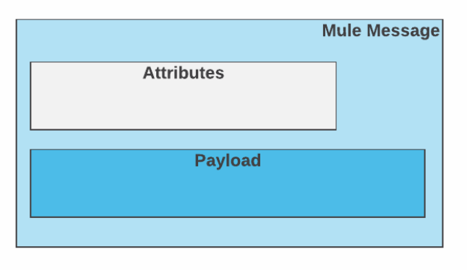
Mule Message Structure

